Slide 1
Cyborg
A pick and place robot
Made by
Raag Ranjan
Bachelor in Technology
Department of Electronics and Communication
National Institute of Technology Patna

Slide 2
About
Cyborg is a remote controlled vehicle capable of lifting and moving small objects with its arm.
This robot participated in Machine Mayhem organized by Robotics Club NIT Patna.
It got appreciation for its unique design and technology.
The robot works on Arduino technology.

Slide 3
Working
It works on Arduino. Arduino is an open-source electronics platform based on easy-to-use hardware and software.
Arduino boards are able to read inputs and give outputs that pre-decided by the programmer/user. It can be programmed by uploading a code to Arduino board using Arduino IDE.
Cyborg has 4 wheels and an arm. It can maneuver in forward, backward, right and left directions.
It also has an arm that can pick and place small objects.

Slide 4
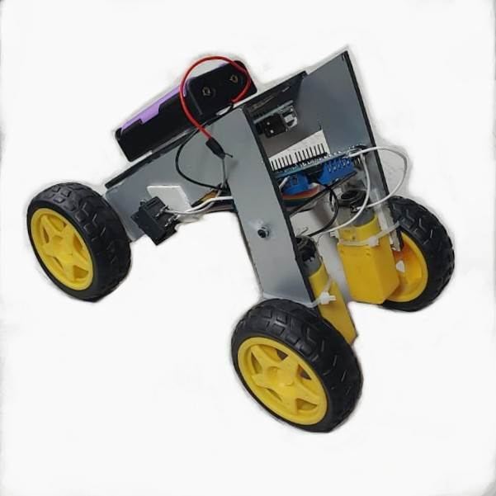
Cyborg

Slide 5
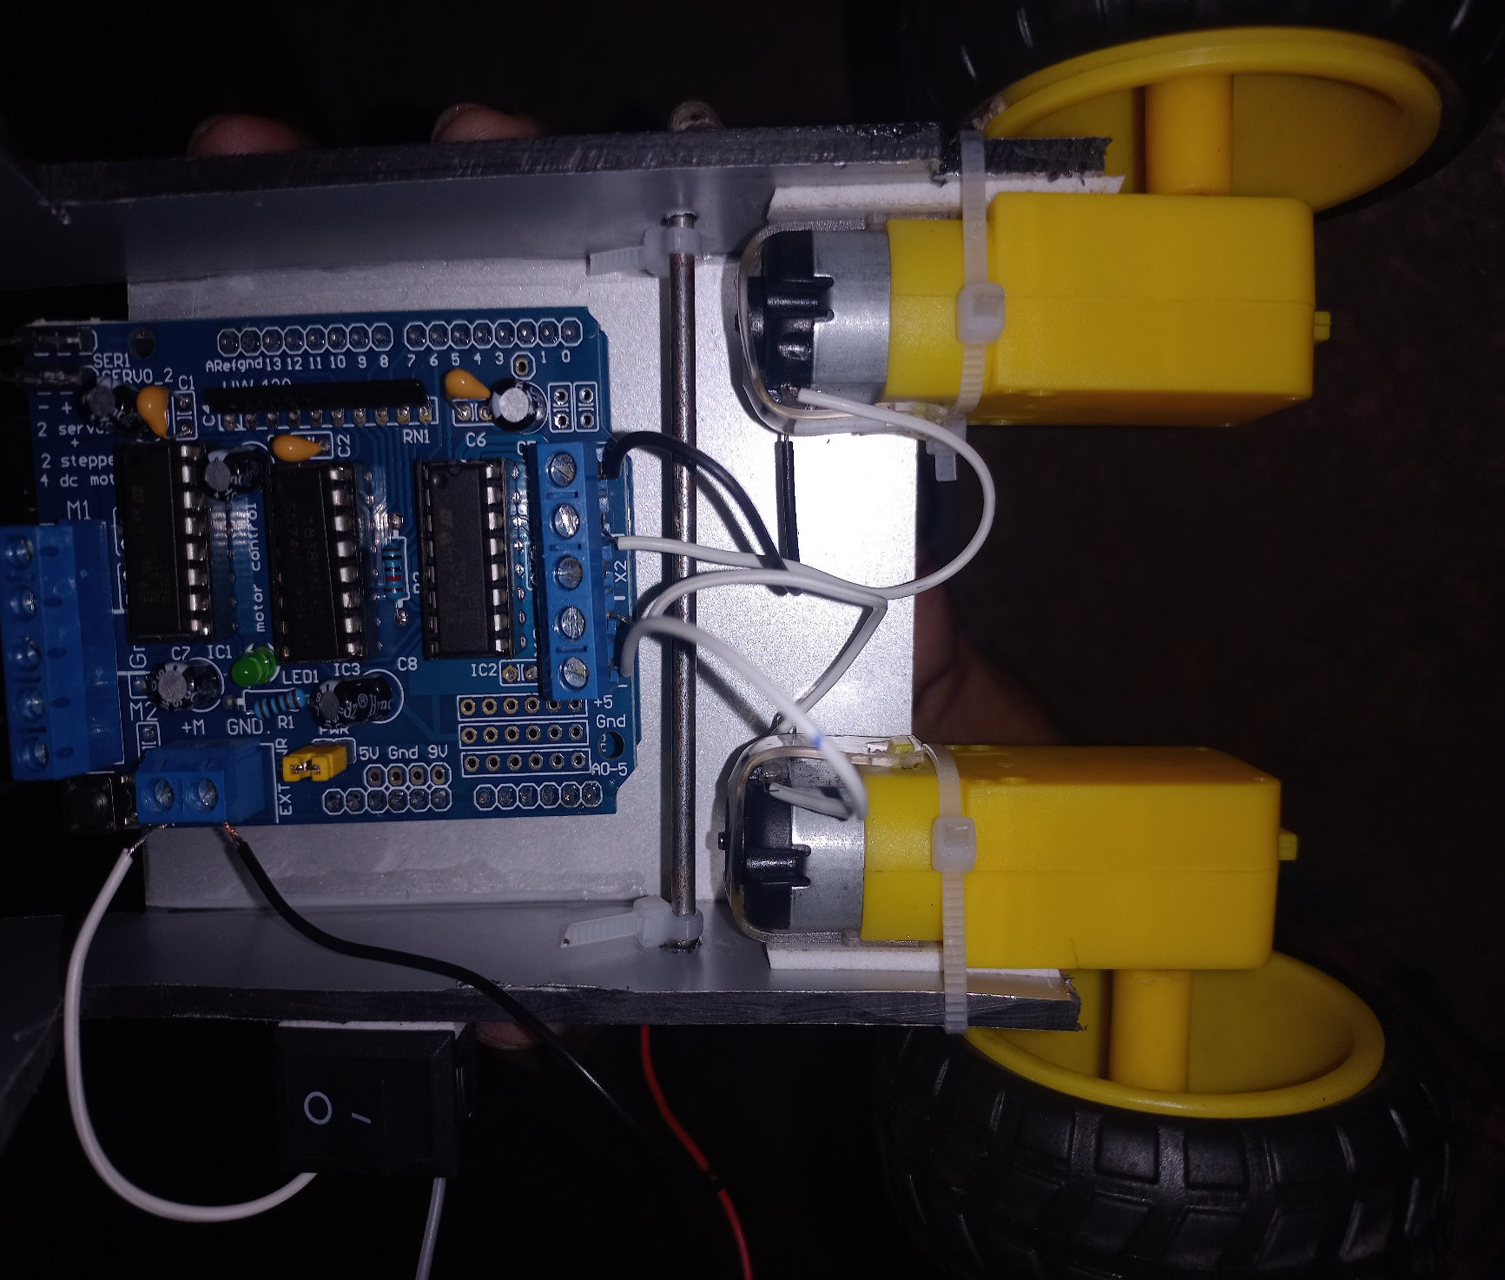
Connection between Arduino Board and Motors

Slide 6
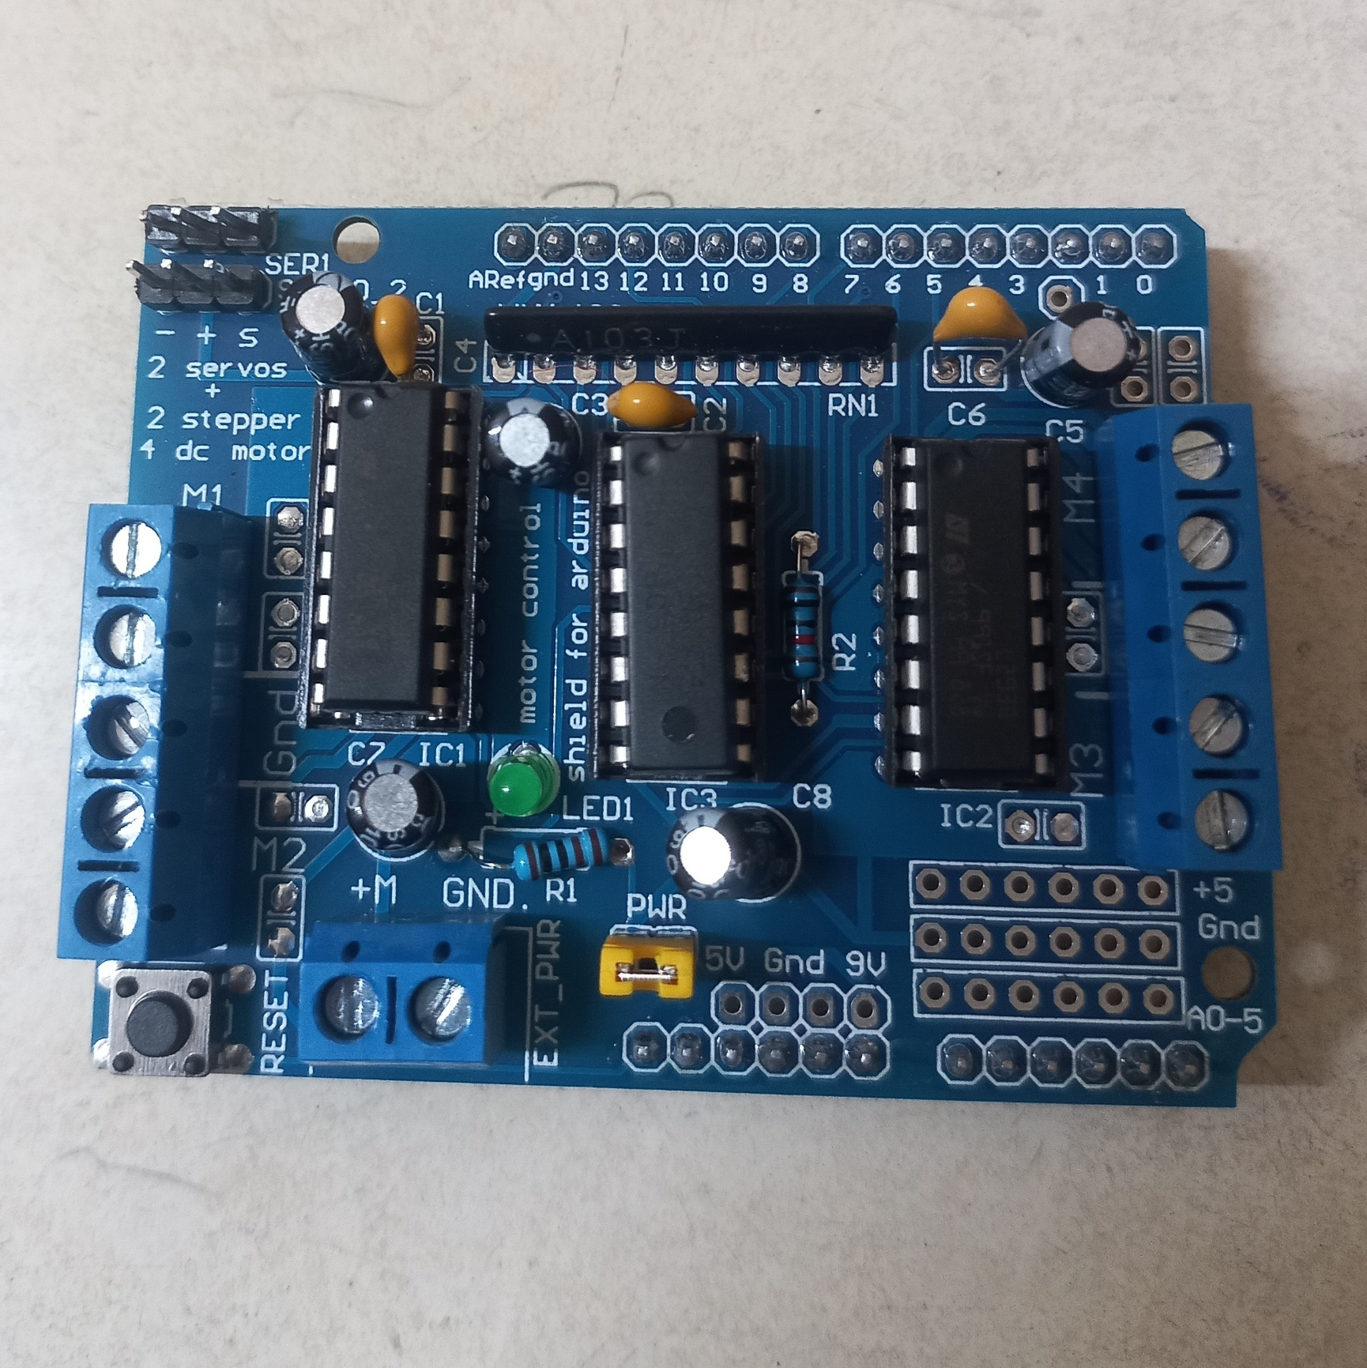
Arduino Board

Slide 7
Acknowledgement
Cyborg robot was made by Team Cyborg which participated in Machine Mayhem organized by Robotics Club NIT Patna.
Team members – Raag Ranjan, Samar Raj, Ayush Kumar. All contributed in the making of this robot.

